Slide 1
Micropython Support for Secure IoT chip
(Firmware development)
Presented by:
Biancaa.R
3122223002025

Slide 2
Outline
Objective
Motivation
Literature Survey( if any)
Introduction
Work
References

Slide 3
Objective
To set up micropython support for Mindgrove’s secure IoT chip.
Test the written bare metal code for all the peripherals.
Document the results and observations.

Slide 4
Introduction
Worked on porting MicroPython to a custom RISC-V Secure IoT SoC.
Aim: run Python scripts directly on bare-metal hardware (no OS support).
Designed hardware abstraction for core peripherals, scientific computation.
(Focused on low-level firmware, memory mapping, and system bring-up.

Slide 5
Motivation
For easier programming of the Secure IoT chip via python.
Easier support for other python modules (for ML)
To enable MicroPython support for Mindgrove’s production-ready secure IoT chip.
To add support for commonly used Python modules and scientific libraries.

Slide 6
Literature Survey( if any)
https://docs.micropython.org/en/latest/
https://github.com/micropython/micropython

Slide 7
Port | Unique Code Design Features | Core OS/Framework | Special Characteristics
STM32 | Uses STM32Cube HAL for hardware abstraction - Supports broad STM32 MCU families with modular board configs - Bare-metal focused, no RTOS dependency - | Bare-metal with STM32 HAL | Direct peripheral register access via Python modules - Advanced support for STM32WB wireless cores and radio - Supports USB, Ethernet, and various MCU families
ESP32 | Built on ESP-IDF framework with FreeRTOS RTOS - Multi-core support and scheduler abstractions in MicroPython - Uses ESP-IDF APIs for deep integration of WiFi, Bluetooth, networking | FreeRTOS + ESP-IDF | Includes networking stacks and wireless driver integration - Supports a variety of ESP32 boards with dynamic flash detection – * Addresses resource-sharing challenges of multi-core and RTOS
nRF | - Nordic SDK-based, with support for multiple Nordic SoCs - Handles dual-core (app + modem) in nRF9160 devices - Bluetooth Low Energy (BLE) stack integration via ubluetooth - Firmware management supports modem + app flashing | Nordic SDK + SoftDevice (optional) | Robust BLE stack with MicroPython APIs - REPL on UART0 for debugging - Focus on wireless IoT connectivity and cellular modem support

Slide 8
File structure:
docs/
drivers/
examples/
extmod/
lib/
logo/
mpy-cross/
ports/
py/
shared/
tests/
tools/
.git-blame-ignore-revs
.gitattributes
.gitignore
.gitmodules
.pre-commit-config.yaml
ACKNOWLEDGEMENTS
CODECONVENTIONS.md
CODEOFCONDUCT.md
CONTRIBUTING.md
LICENSE
README.md
pyproject.toml
Category | Purpose
Lexer/Parser | Convert source code into tokens and AST
Compiler | Turn AST into bytecode (mp_bytecode)
Runtime VM | Bytecode interpreter + object model
Object System | Implementation of Python types, objects, and protocol behavior
Garbage Collector | Memory management for dynamic object lifetime
Utilities | Interning, formatting, small string helpers
I/O + Errors | Standard errors and stream abstraction

Slide 9
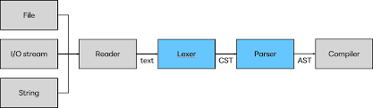
Flow diagram:

Slide 10
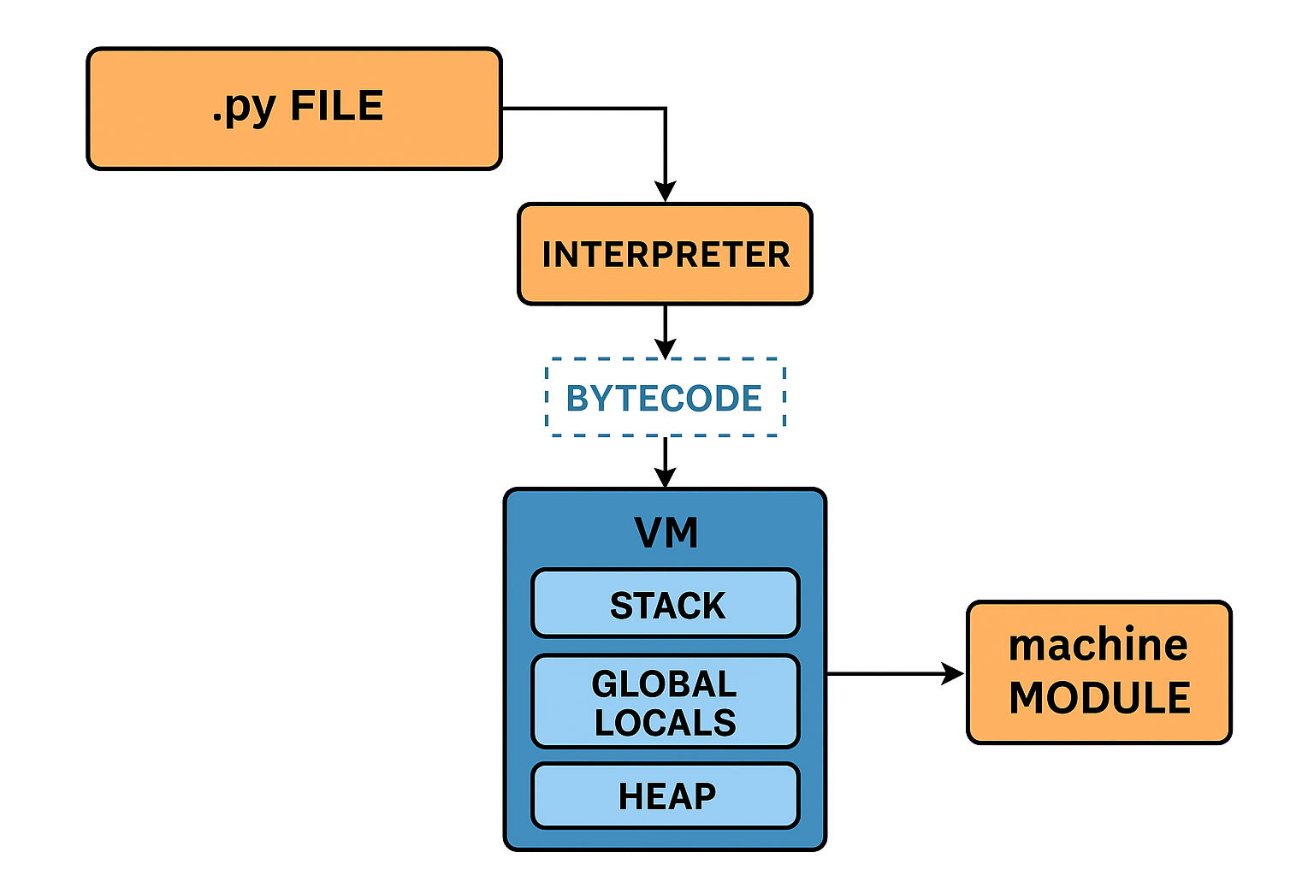
Flow diagram:

Slide 11
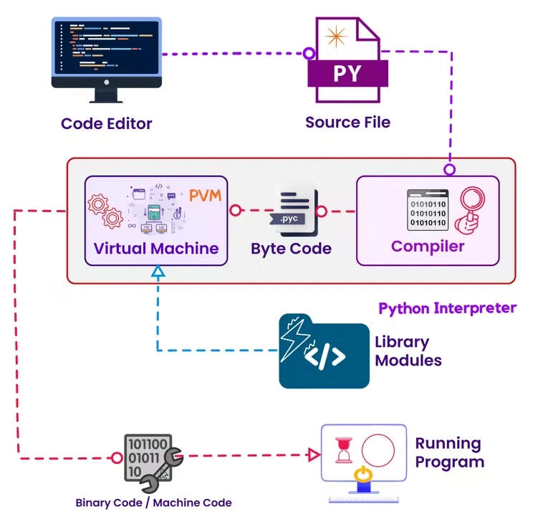
Flow diagram of entered program:

Slide 12
Work
> Setup micropython. > Wrote baremetal drivers
(GPIO,Pwm,UART,SPI,I2C,GPTimer,WDT,RTC) .
Numpy,scipy ,random,vector,math,ulab,linalg and io.
Added support for time ,with hardware peripheral (clint timer).
Developed a pseudo random > Setup a random module from scratch.
Fixed an issue in traps.c
external interrupts and modified traps.c for the same.
Added support for epoch calculation with rtc ,connected via i2c protocol.
Handled ecall from m-mode exception
> Tried adding support for tflite micro as a module with micropython. > Tried writing the drivers for QSPI.

Slide 13
Work: drivers
GPIO: Support for input/output, pin configuration, and interrupts.
PWM: Channel configuration for duty cycle and frequency.
UART: REPL communication and arbitrary serial data exchange.
SPI & I2C: Master-mode,slave support for peripheral communication.
GPTimer & WDT: Timer-based callbacks and watchdog resets.
RTC (via I2C): Real-time clock initialization, reading epoch time, and setting system time.

Slide 14
Work
Depth of Firmware Work
Debugging: Working with GDB, OpenOCD,triggers, and breakpoints helped me understand the art of finding invisible bugs.
Embedded programming with Micropython
Documentation.

Slide 15
Work done:
Platform Integration
new port directory
Implemented board-specific initialization (startup, RAM/heap setup, build scripts).
Build Process & Toolchain
Adapted Makefiles to support Secure IOT hardware build.
MicroPython cross-compiler
Runtime Features
Enabled MicroPython VM, REPL, garbage collector, and core modules on the Secure IOT platform.

Slide 16
Work done:
Repository: https://github.com/Mindgrove-Technologies/micropython
Documentation: https://beneficial-death-54e.notion.site/MicroPython-1f9dbd81469780e4927ee078bed18b68?pvs=143

Slide 17
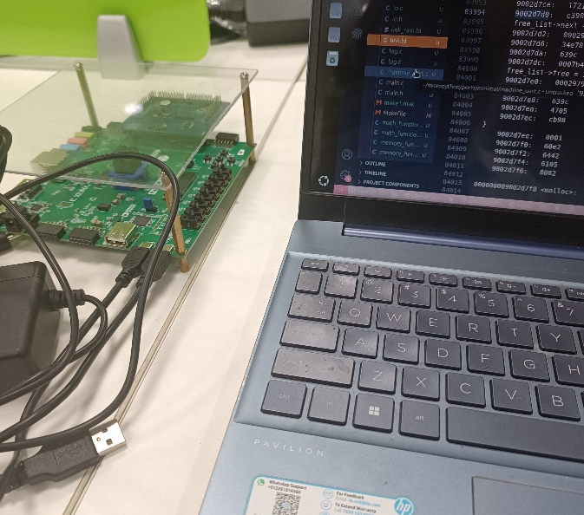
Emulated the chip with Nexys A7 FPGA board.

Slide 18
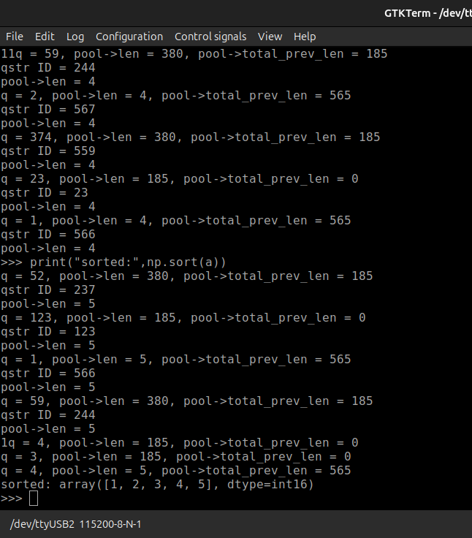
Op: Array sorting with Numpy:

Slide 19
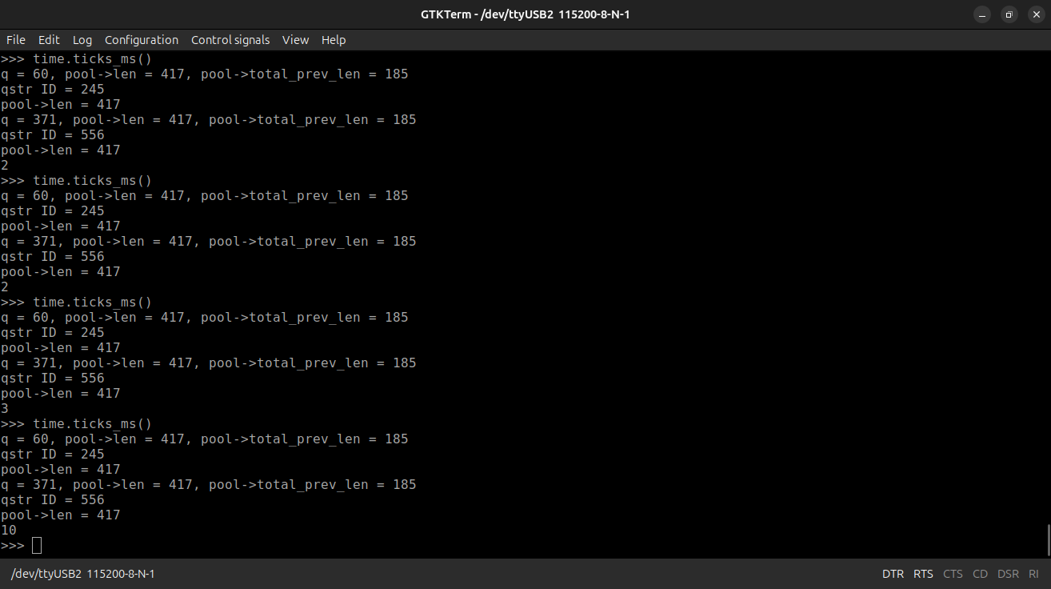
Time module :Ticks

Slide 20
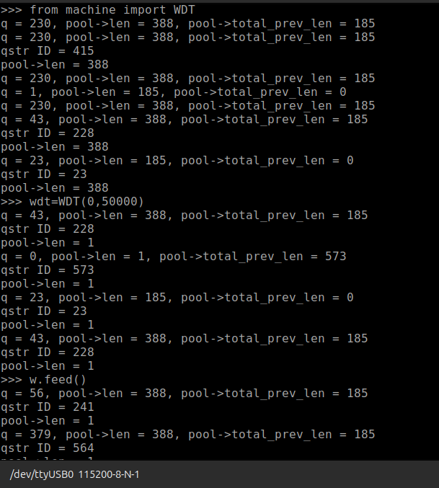
Using the WDT:

Slide 21
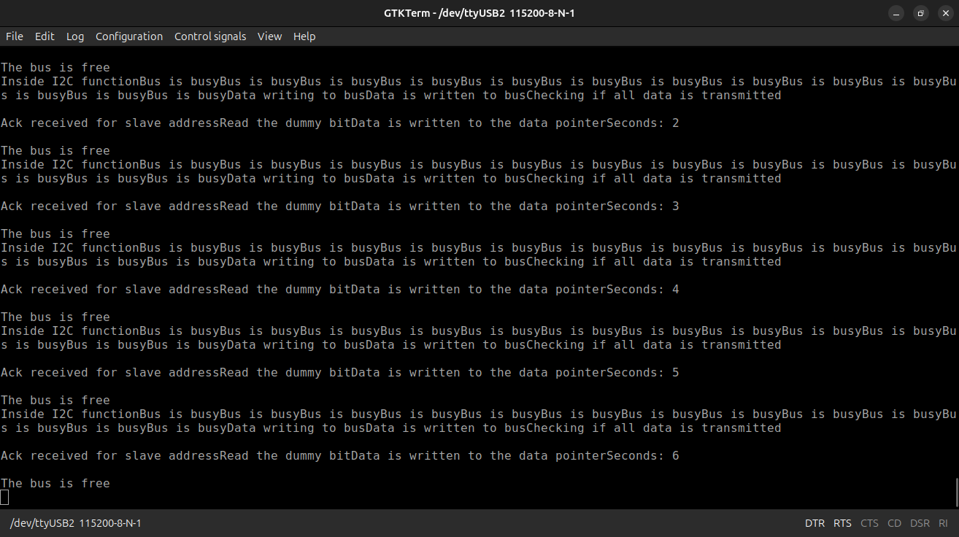
Using I2C protocol:

Slide 22
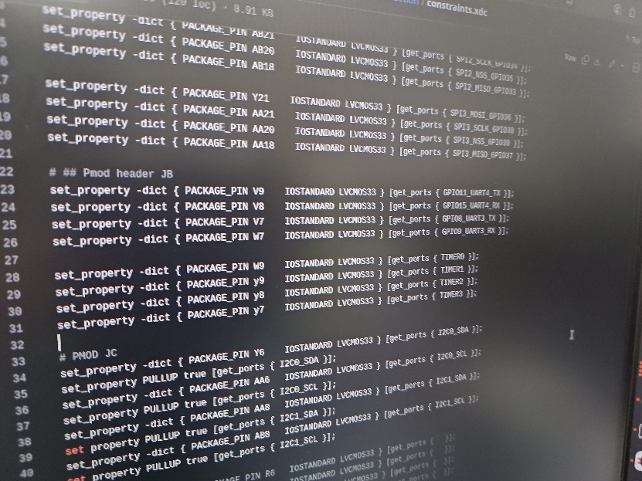
Selected mcs file:

Slide 23
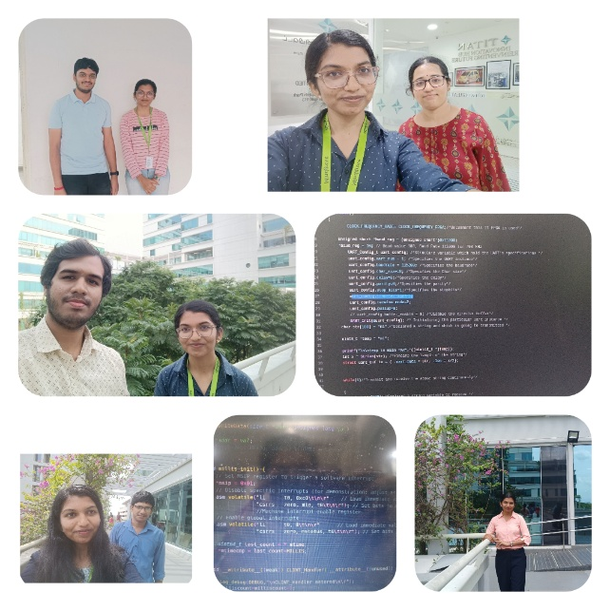
The End Thank you

Slide 24
References
https://microcontrollerslab.com/microcontrollers-startup-file-arm-cortex-m4-mcu/
https://embeddedwala.com/Blogs/embeddedsystem/how-startup-code-works#google_vignette
https://www.dmi.unict.it/santoro/teaching/lsm/slides/StartupSTM32.pdf
https://www.shiksha.com/online-courses/articles/static-variables-in-c/
https://www.codequoi.com/en/local-global-static-variables-in-c/
https://www.youtube.com/watch?v=f68zFRgnaWo&t=857s —> Not working for me
Serial comm: https://github.com/Biancaa-R/Serial_comm_riscv/tree/main
MBOOT , micro bootloader for python in stm32 https://forum.micropython.org/viewtopic.php?t=5961
https://github.com/micropython/micropython/tree/master/ports/stm32/mboot#example-mboot-on-pybv1x
https://github.com/micropython/micropython-example-boards/tree/main —> basic examples
https://github.com/orgs/micropython/discussions/11612
Specific to esp 32/8266:
https://www.horan.hk/blog/micropythonesp32/

